Slide 1

GROUP 9
STREAMING SERVICE
PREPARED BY GROUP 1:
ABELLA, JUSTINE NICA
HERMOSURA, JONNAH
MASANGCAY, JC
SAAVEDRA, VINCENT PAUL

Slide 2
Linked List
A linked list is a linear data structure that can store a collection of items. Like arrays, linked lists are used to store several objects of the same type. It is a common data structure made of one or more than one nodes. Each node contains a value and a pointer to the previous/next node forming the chain-like structure. These nodes are stored randomly in the system's memory, which improves its space complexity compared to the array.

Slide 3
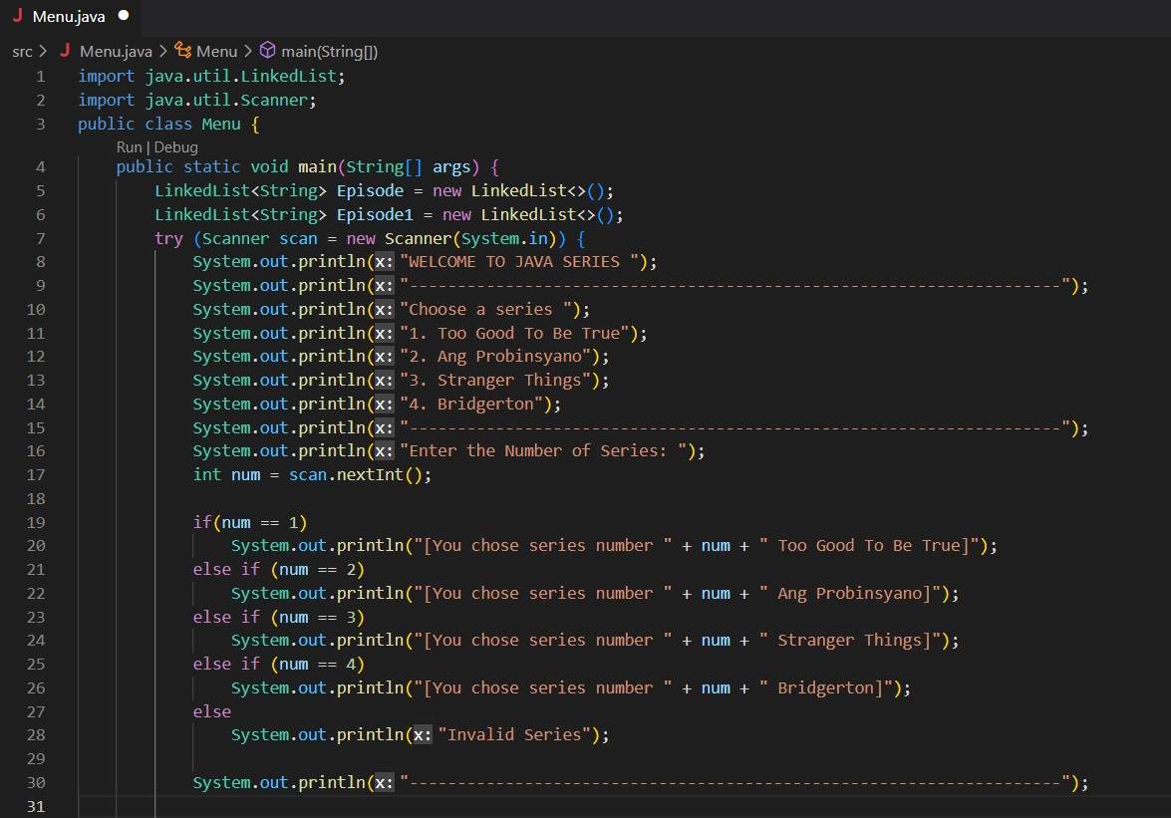

Slide 4
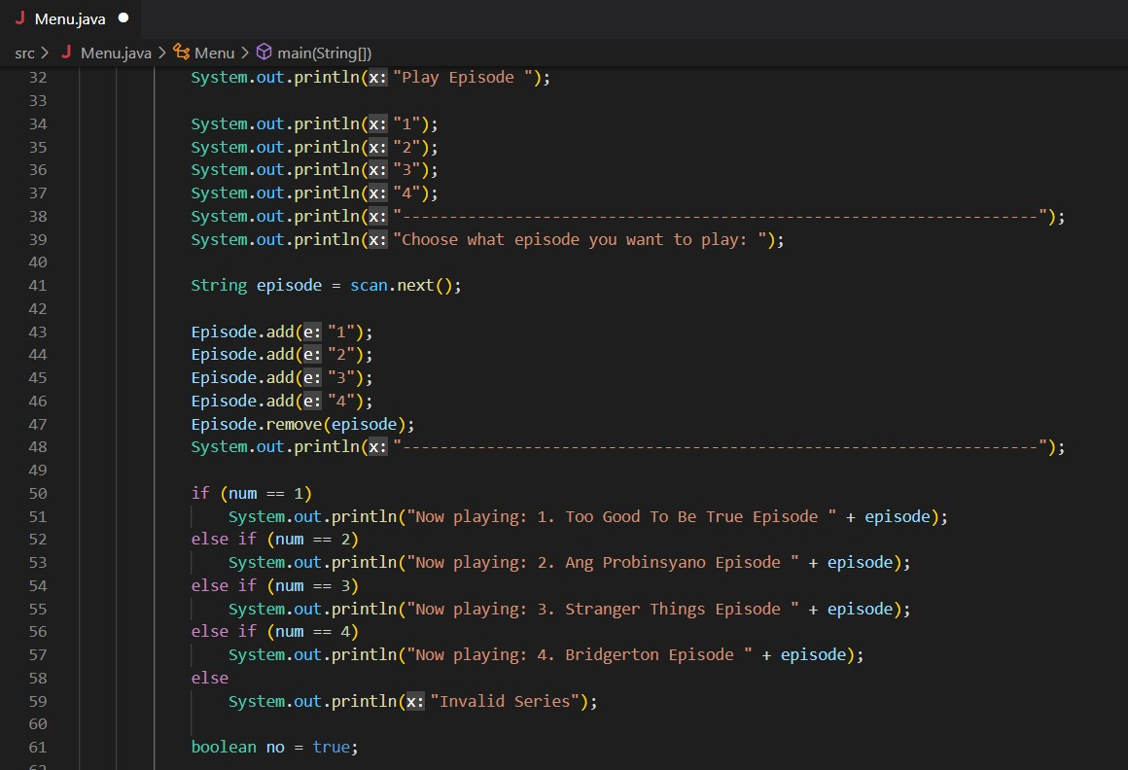

Slide 5
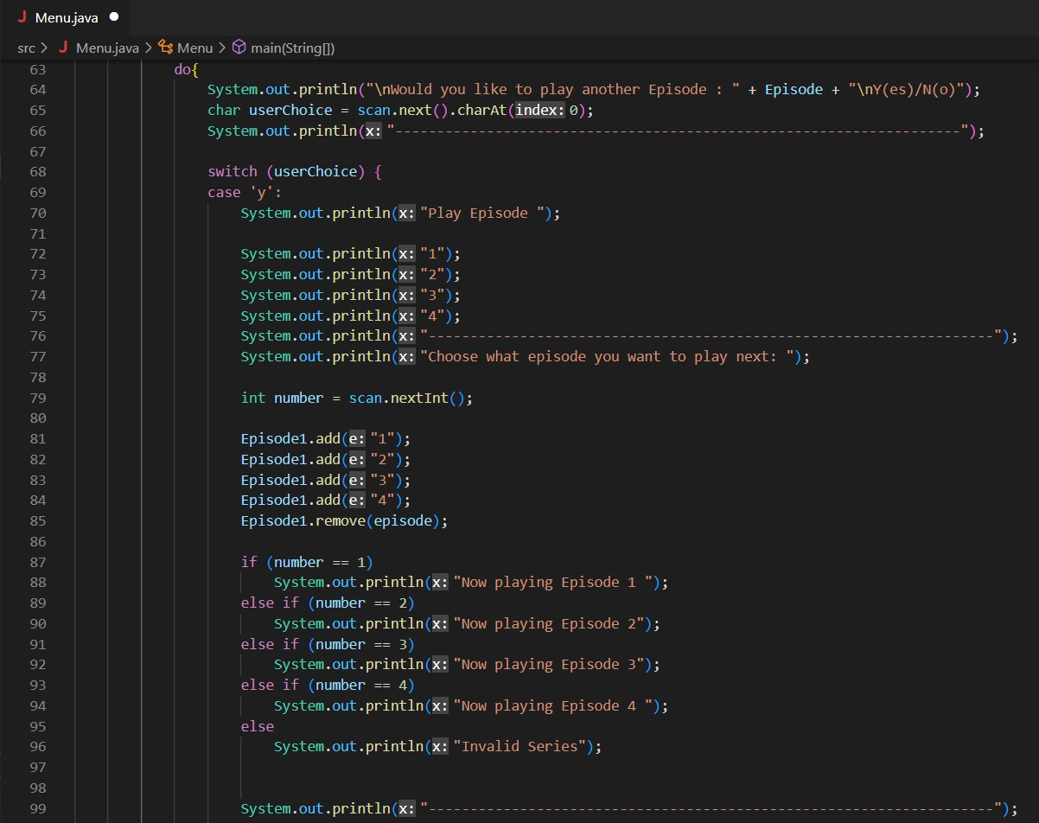

Slide 6
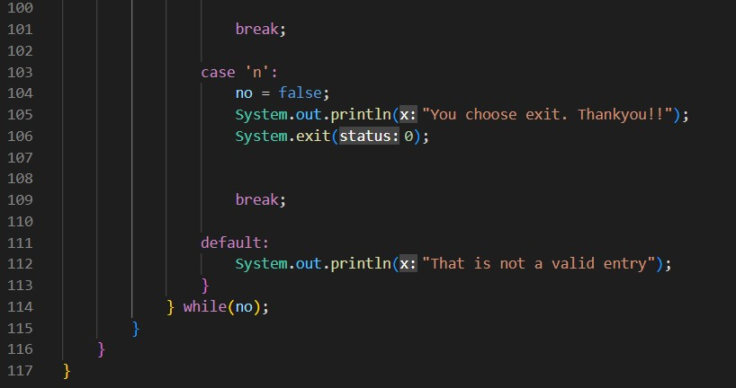

Slide 7
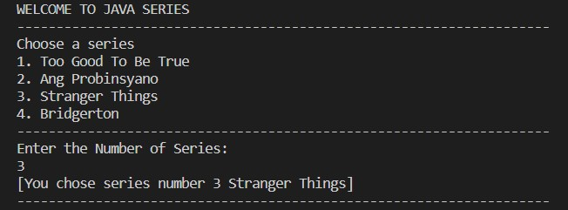
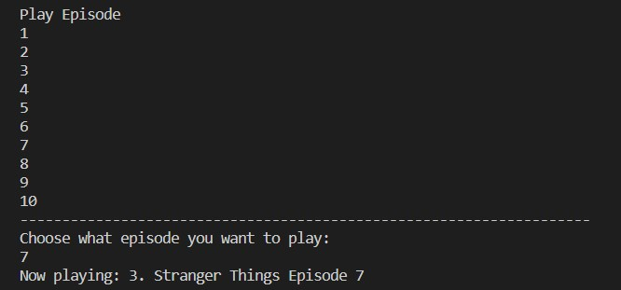
Implementation Results

Slide 8
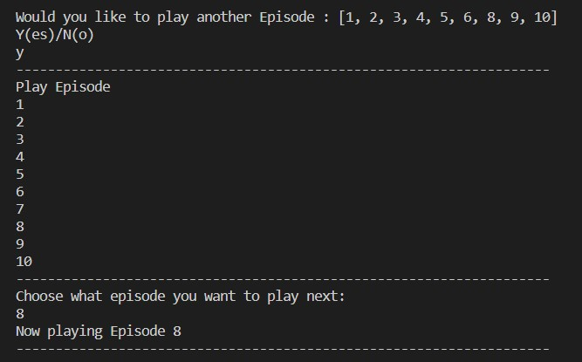
Implementation Results

Slide 9
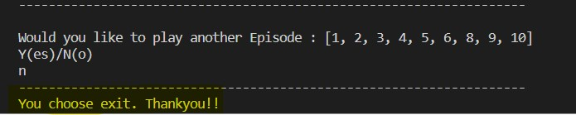
Implementation Results

Slide 10
THANK YOU….

